Slide 1
Agenda
Performance Testing: Process Flow
Performance Testing Artifacts
Results shared with all stakeholders
Performance Testing Capabilities
Artifacts and Sample Documents

Slide 2
Performance Testing: Process Flow
.
Best Practice - QA Lead to check in scrum call for performance testing scope and update the Flight Plan/ MTP
Inform performance team about timeline
For Other LOB’s - QA Manager/Dev Manager to contact Performance Team for any performance testing requirement
Performance Lead to set up call with Dev/BA/Architect/QA for requirements
Update the Performance Testing Questionnaire
New Application
POC for application and tool compatibility
Check the Calendar for resource availability and allocation
Gather all the non-functional requirements
Update Performance Test Plan
Create Scripts/Scenarios
Execute Dry Runs
Executing Scheduled Test s and Monitoring
Share Test Results and Observations
Walk through the results
If tuning required
Application Tuning
Executive Summary Report
Sign Off

Slide 3
Performance Testing Artifacts
Following are key activity documents –
Performance Testing Questionnaire
It will help us to understand the details of the application with respect to software, hardware, and also to determine whether team can support the testing activity or not.
Performance Test Plan
The document will provide detailed information on the types of testing to be done, no of user, test scenarios, approach, list of all stakeholders, sever details etc.
Executive Summary Report
Once all the testing is completed the summary of all the observations, results, server utilizations, tuning if any, defects etc. are all accumulated and documented in the executive summary report and shared with all the stake holders.

Slide 4
Performance Results
Following will be shared with the stakeholders after each test–
Objective of test
Test Scenario details:
Max users
Test time
Test duration
Environment etc.
Observation on the response numbers (Min, Avg, Max,90%, 95%,std deviation, pass count, fail count), throughput, server utilization etc. If any other important observations specific to test will be included.
Action Items: Any action items for next tests will be listed.
If we have a baseline for comparison, top 5 to 10 transaction showing high variance/improvements will be listed in a table and shared over the email.
Graphs from test
Graphs or screen shots from monitoring tools eHealth/ AppDynamics/ vRops etc. for hardware utilization.
Response number comparison graph, error rate graphs, Transaction vs user graph etc.

Slide 5
Performance Testing Capabilities
Web based application Testing
Testing application on citrix
API/ Web Service testing
Testing application on Mobile Browser
Testing applications built on Oracle Forms
Capability to test application on different geographical locations using Visual Studio Online, where the agents are hosted on Microsoft Azure Cloud
DevOps - Continuous Integration using Jenkins

Slide 6
Artifacts and Sample Documents

Slide 7
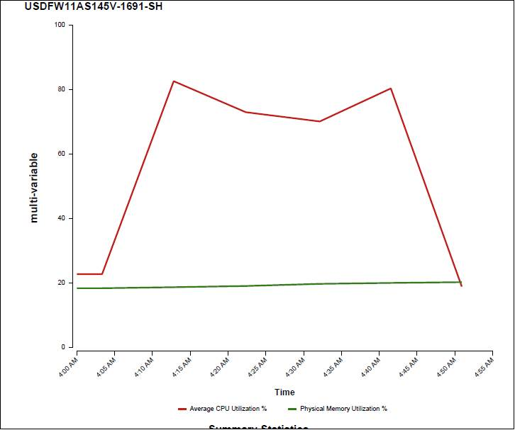
Server Monitoring Samples
eHealth Tool

Slide 8
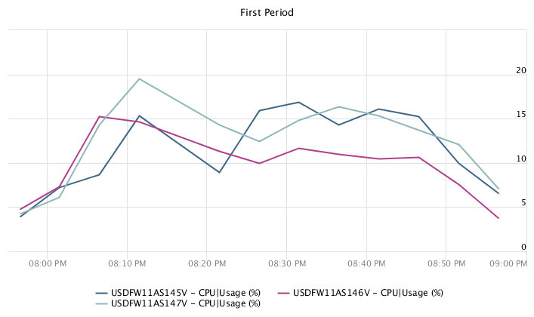
Server Monitoring Samples
vRops Tool

